Slide 1

Rajgad Dnyanpeeth’s ,
Shri Chhatrapati Shivajiraje College of Engineering
Department Of Electronics and Telecommunication Engineering
RFID and IOT based Attendance monitoring System
Presented By:
1.Poonam Dhanaji Devkar B190713006
2.Komal Balaso Walhekar B190713039
3.Payal Ashok Kanse B190713015
Class-BE E&TC
Guide:
Prof. S. R. Nalage

Slide 2
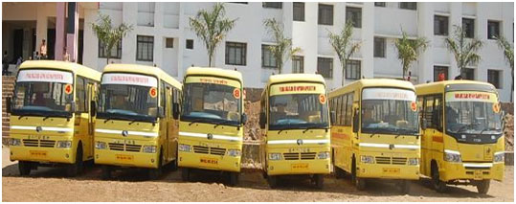
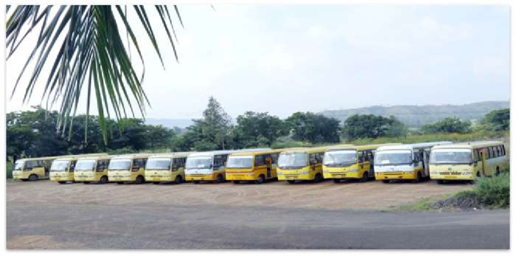
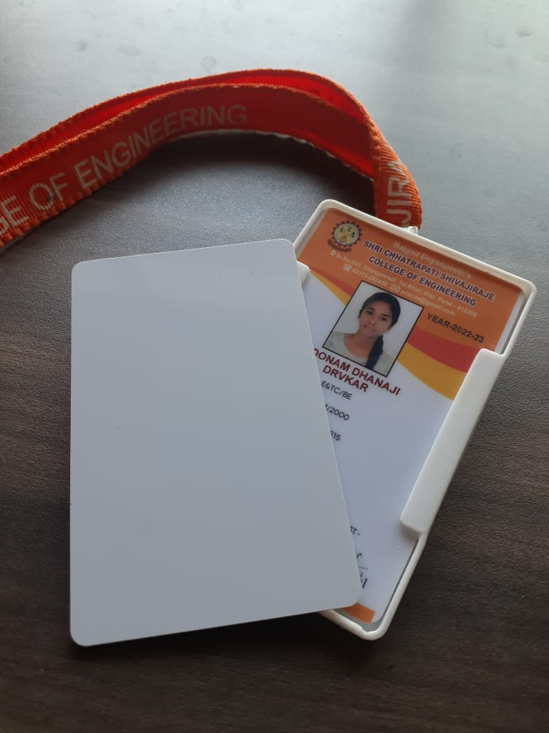
Idea

Slide 3

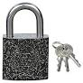
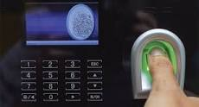
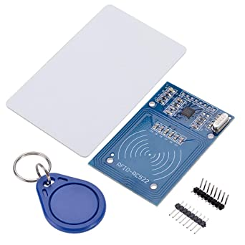
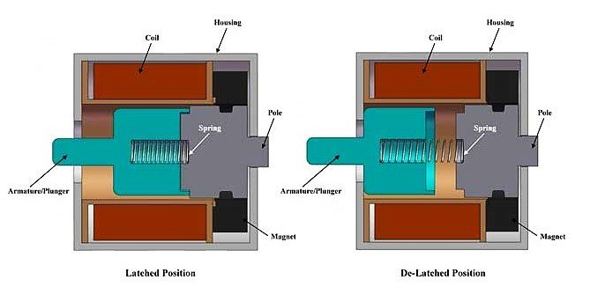


Introduction
Traditional Method
Google Cloud
Lock
RFID

Slide 4
Literature Survey
Sr No | Author | Title | Year and Publication Name | Propose & Method
1 | Dr. Stya Shrikant Shilpa Shree.K | RFID based system for school children Transportation safety | 6 June 2022 | The technology being used to should be crucial enough to keep our society safe. To Improve Transportation Safety.
2 | Astha Preeti Gulia | Review on security of RFID | Nov-2017 | Widely applied in supply management smart antitheft networking
3 | Litty Rajan, Alpana Gopi | RFID based vehicle authentication using Smart card | 3 march 2017 | The aim of this survey is to find RFID application in authentication of all vehicle during inspection.

Slide 5
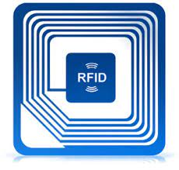
RFID stands for
Radio Frequency Identification and detection

Slide 6
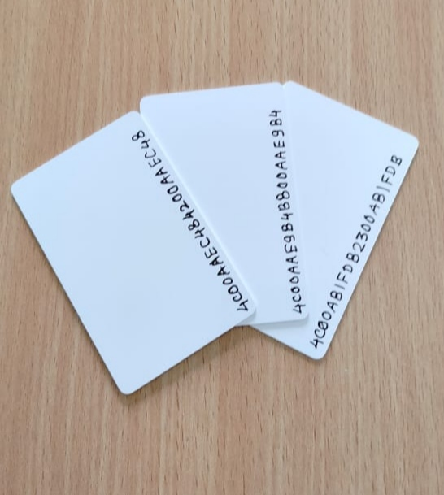
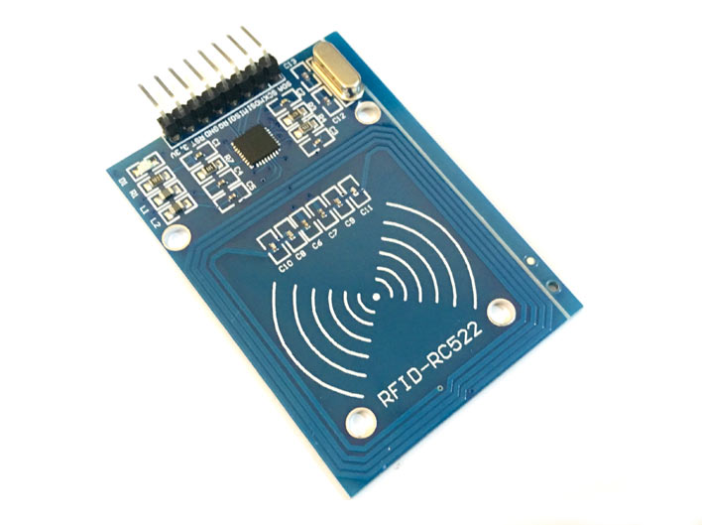
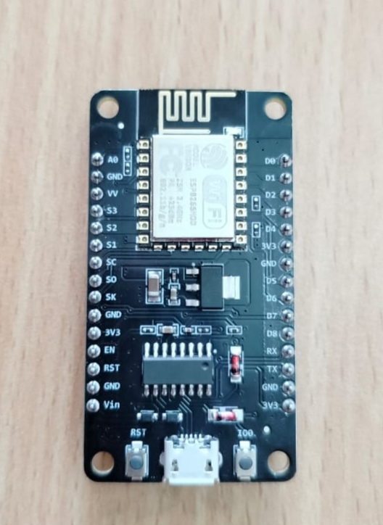
Hardware components
RFID Tags
Rfid reader
esp8266

Slide 7
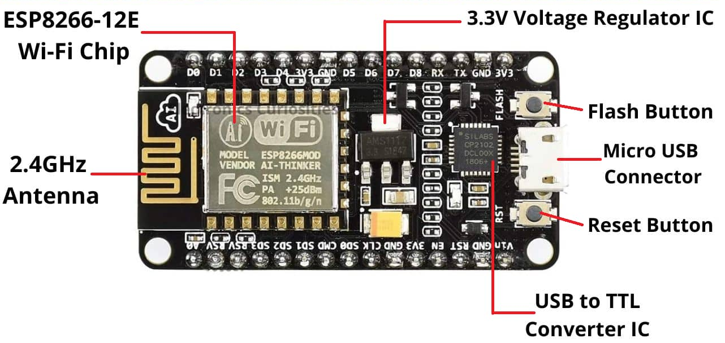
Why esp8266
ESP8266 is a popular wifi-enabled microcontroller.
Wifi connectivity:
Low cost:
Open-source:
Easy programming:

Slide 8
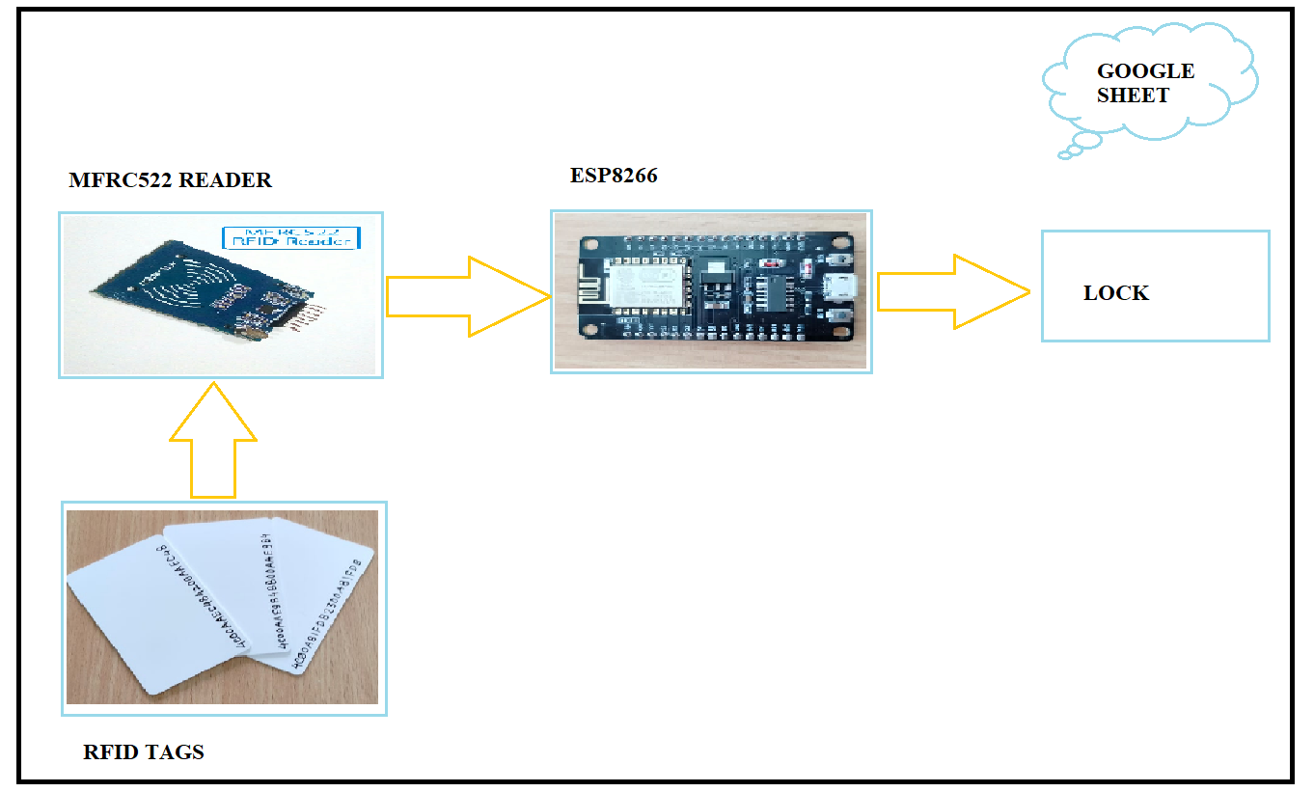
System overview

Slide 9
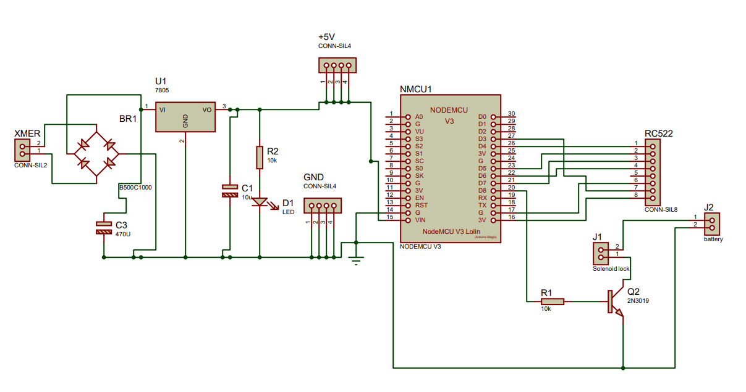
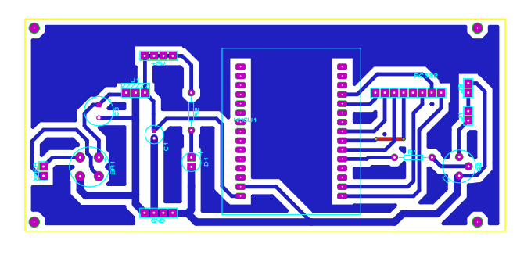
Circuit Diagram PCB Layout

Slide 10
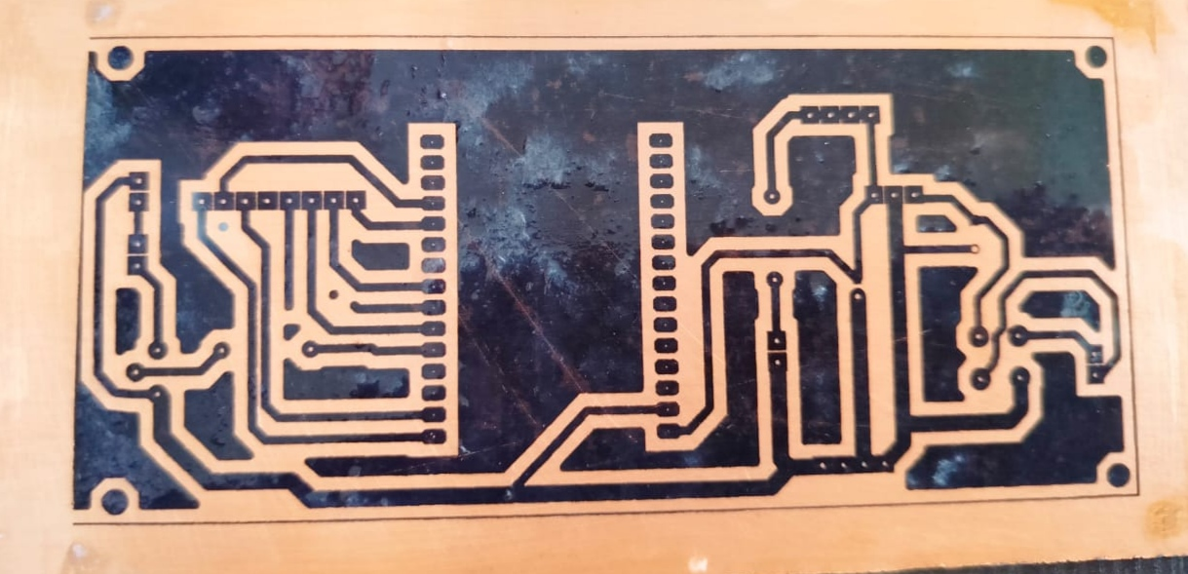
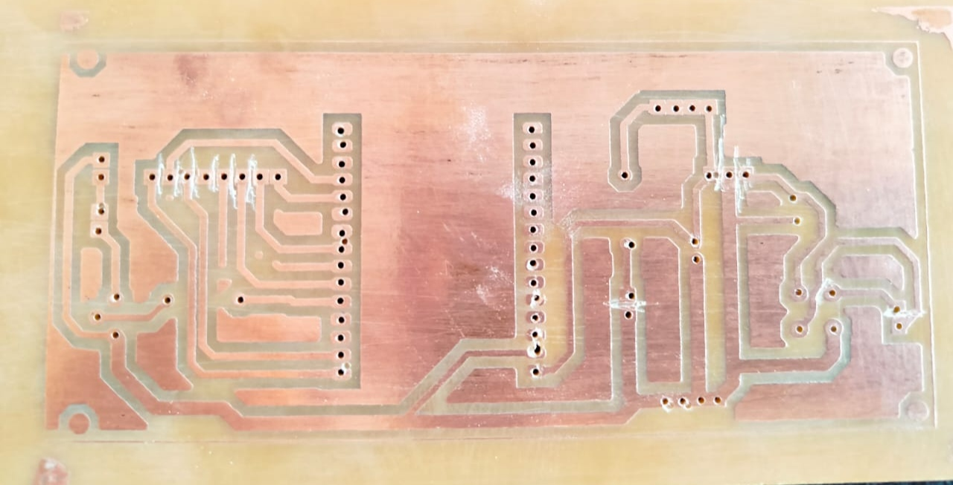
PCB Fabrication
UV explosion
Etching

Slide 11
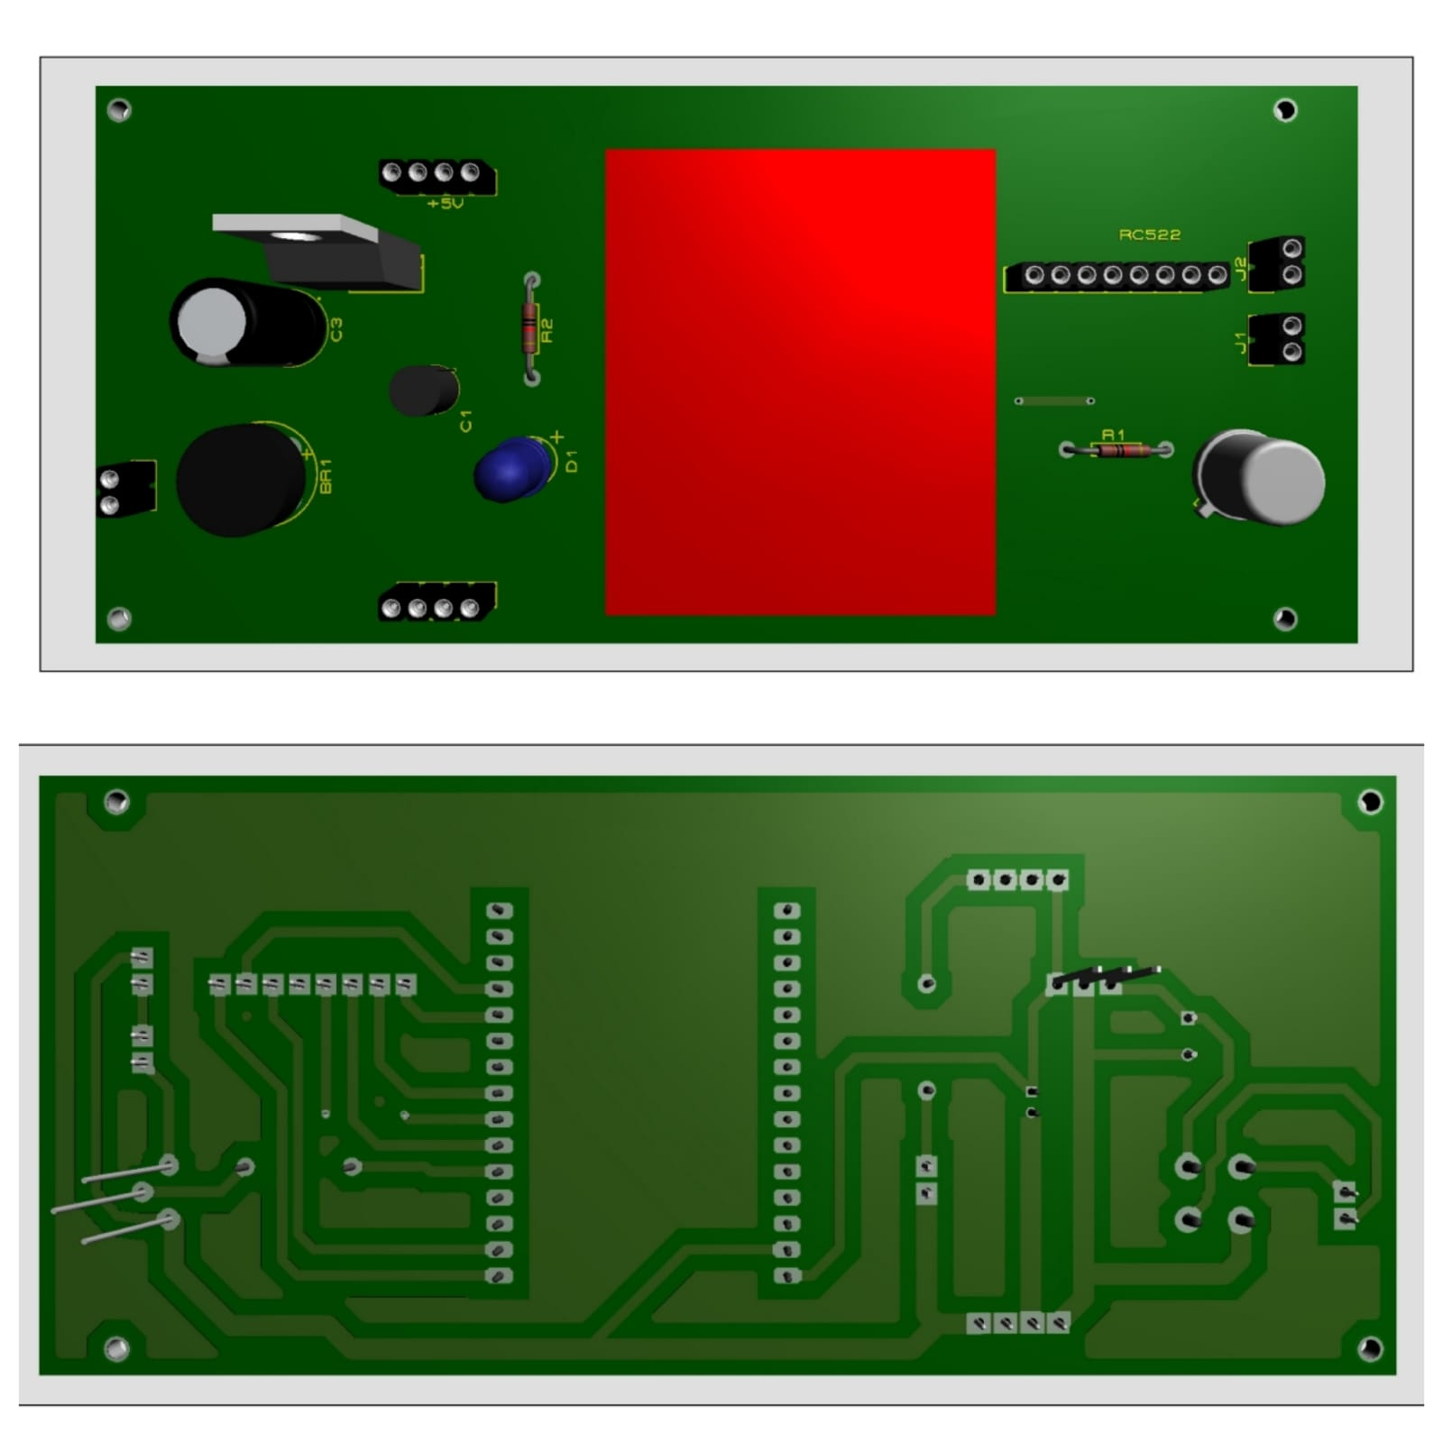
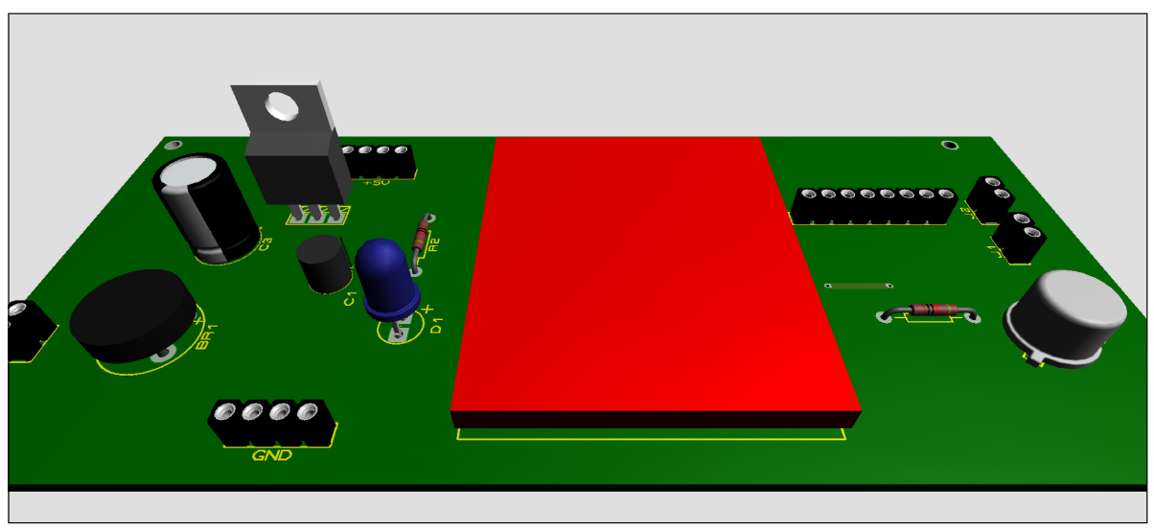
3D View Of PCB

Slide 12
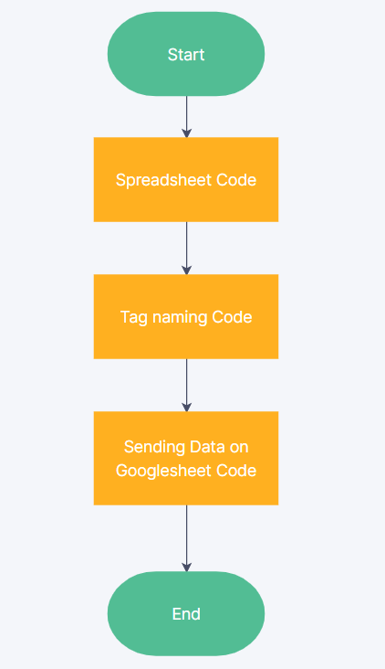
Software Flowchart

Slide 13
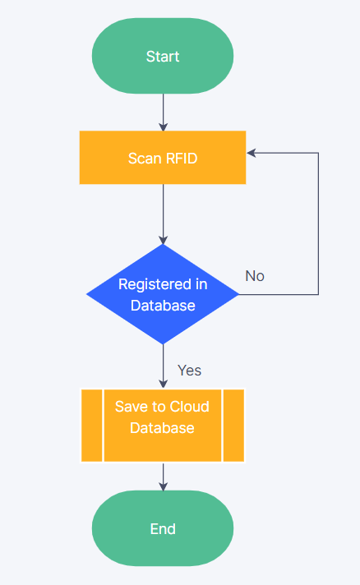
Hardware Flowchart

Slide 14
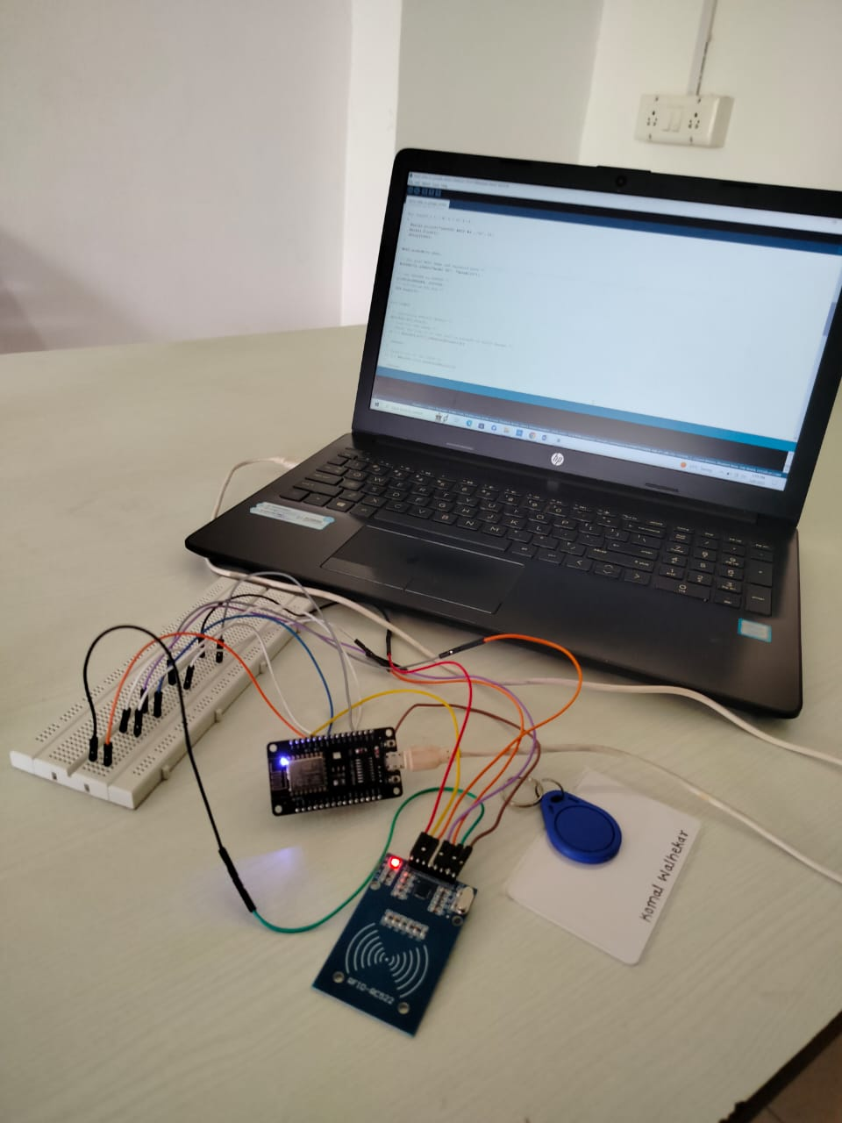
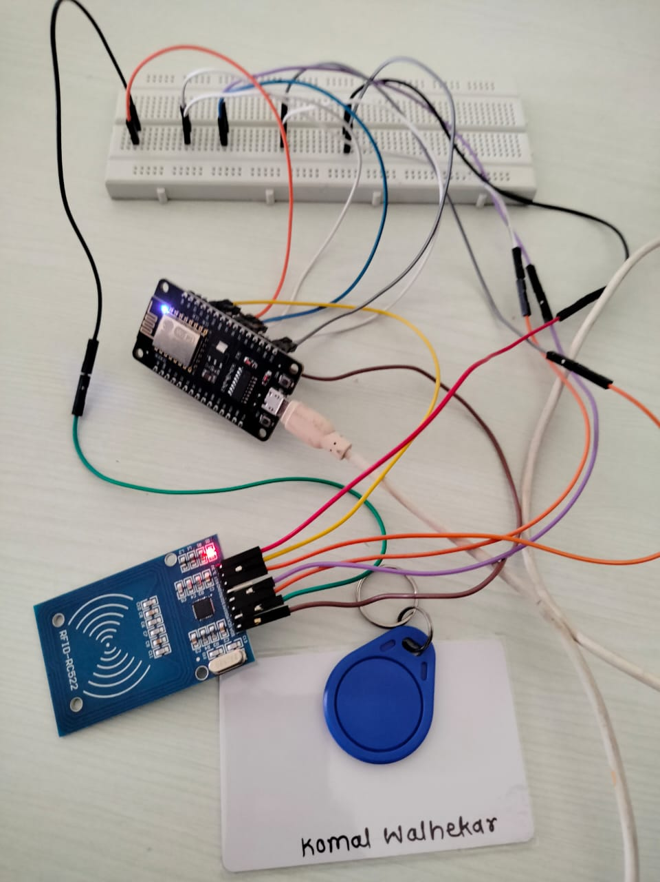
Module testing

Slide 15
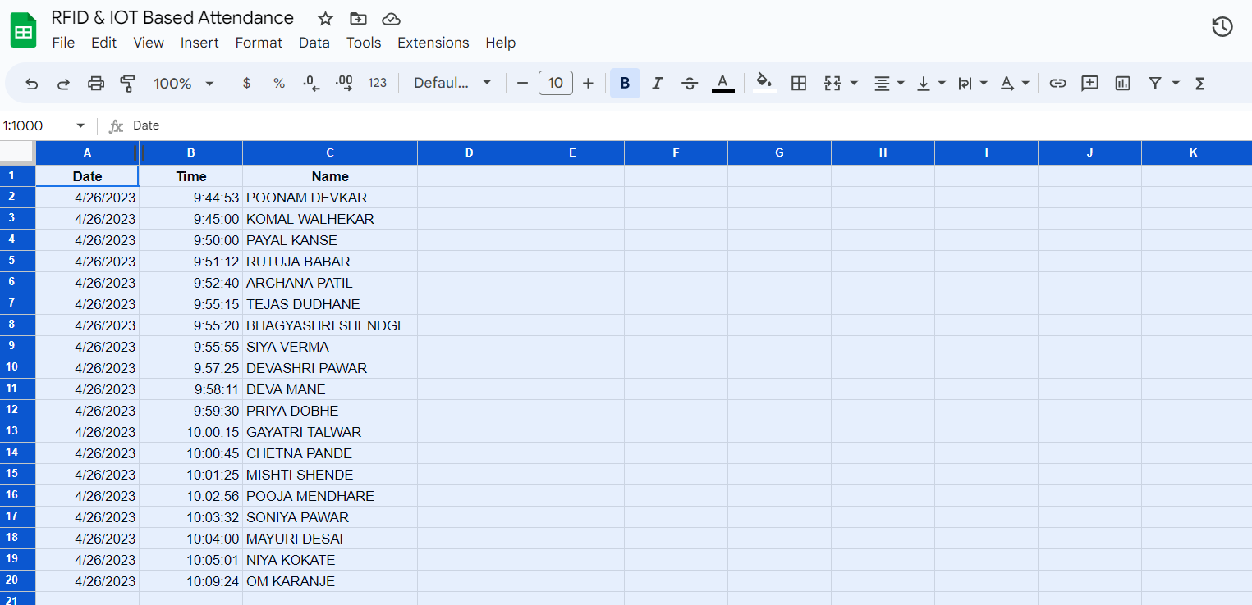
Result- Google sheet

Slide 16
Advantages
The system provides a more accurate identification.
Quick and rapid: identifies candidates in seconds.
The system is less tedious, cost-efficient, easy to use, hard to adulterate, and modest.
Educational institutions like schools, colleges, and universities can precisely screen the regularity of students, teachers, and working staff .

Slide 17
Disadvantages
Dependence on internet connectivity.
Limitations in range.
Tag proxy.

Slide 18
How to overcome proxy
Proxies can be a challenge in Rfid and Iot-based attendance monitoring systems, as they can be used to tamper with attendance data. here are some measures that can be taken to overcome proxies:
Use biometric authentication:
Implement security protocols:
Use multiple checkpoints:
Monitor attendance data:
Educate employees/students:
Overall, a combination of technical measures and education can help in overcoming proxies in rfid and Iot-based attendance monitoring systems

Slide 19
Future scope
Voice announcement system.
The structure can be upgraded by surrounding it in a cling wrap.
Counter and LCD display.

Slide 20
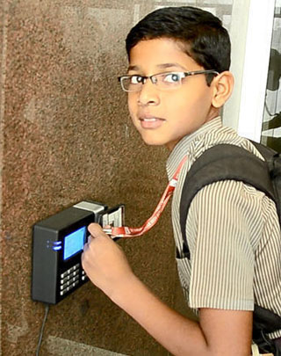
conclusions
This project is a full system for student monitoring in colleges and high education institutes.
The device is supported with friendly using software for data analysis and previewing.
Attendance data now easily uploaded to database.

Slide 21
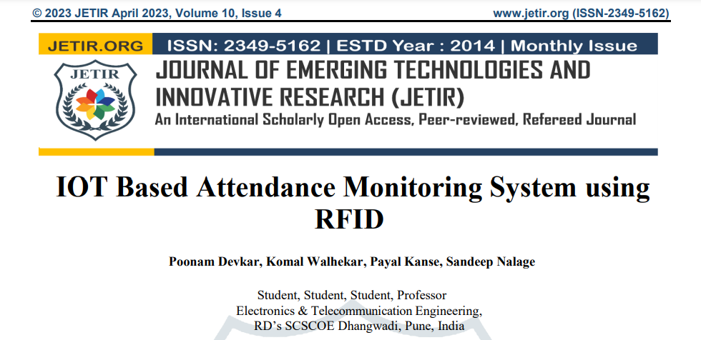

Slide 22
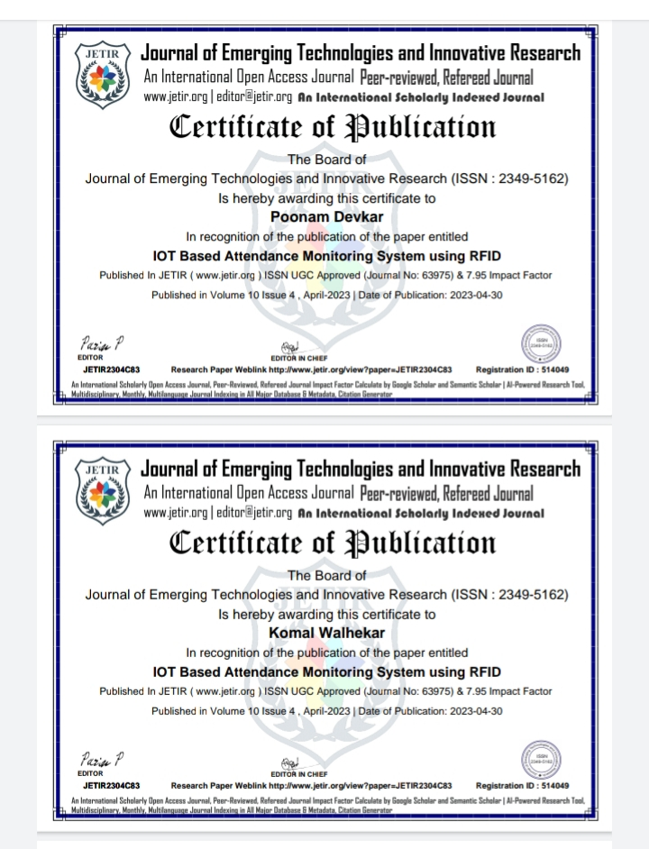
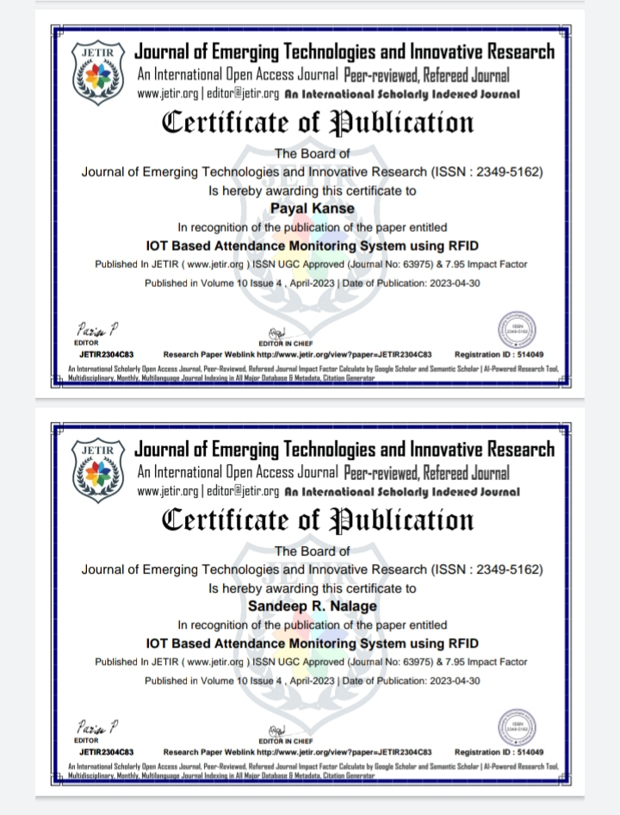

Slide 23
references
Bharathy G.T , tamilselvi tt “smart attendance monitoring system using iot and RFID” june 2021 international journal of advances in engineering and management (IJAEM) volume 3, issue 6 june 2021, pp: 1307-1313 www.Ijaem.Net ISSN: 2395-5252
Rinku bhagat1 “an MQTT based iot-rfid attendance system using node MCU” international research journal of engineering and technology (IRJET) e-issn: 2395-0056 volume: 07 issue: 06 | june 2020 www.Irjet.Net p-issn: 2395-0072 © 2020, IRJET
Joseph dedy irawan, emmalia adriantantri, and akh farid. ”RFID and IOT for attendance monitoring system” MATEC web of conferences 164, 01020 (2018) https://doi.Org/10.1051/matecconf/201816401020 ICESTI 2017
Alsan parajul april 23, 2020 “RFID based attendance system using node MCU with PHP web app”
Https://www.Usmartcards.Com/2020/01/24/rfid-technology-what-are-its-uses-in-the-transportation-industry/
Https://www.Transportbusiness.Net/features/rfid-transportation
Https://www.Researchgate.Net/publication/283479988_rfid-based_system_for_school_children_transportation_safety_enhancement
Https://www.Irjet.Net/archives/V4/i3/IRJET-V4I3392.Pdf
Https://matlabprojects.Org/rfid-based-system-for-school-children-transportation-safety-enhancement/

Slide 24
Thank You

